Slide 1

CS2009 Design and Analysis of Algorithms
Bellman Ford Algorithm

Slide 2
Bellman Ford Algorithm
It is single source shortest path algorithm like Dijkstra. Single source shortest path means to find shortest path from a source vertex to every other vertex in graph.
It works by traversing all edges V-1 times (where V is number of vertices).

Slide 3
Bellman Ford Algorithm
Advantage of bellman ford :
Dijkstra fails many times when there is edge with negative weight in graph.
Bellman ford algorithm works well with negative weights

Slide 4
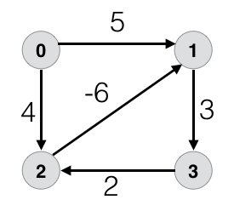
Bellman Ford Algorithm
Dis-Advantage of bellman ford :
If there is negative weight cycle in graph, then bellman ford algorithm will not be able to find shortest path. Negative weight cycle means if there is any cycle in graph such that sum of weights of all edges involved in that cycle is negative number.
If you want to check if graph has negative weight cycle or not then :
After performing (V-1) iterations, perform one more iteration and check if value of any vertex gets updated. If value of any vertex gets updated then it means graph has negative weight cycle and bellman ford did not work correctly. But if value of any vertex does not get updated then it means it does not have negative weight cycle and bellman ford worked well.

Slide 5
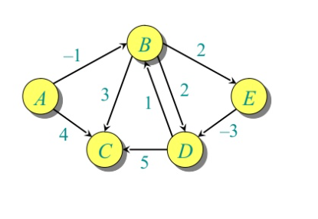
Bellman Ford Algorithm

Slide 6
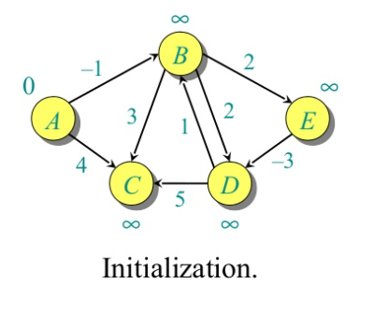
Bellman Ford Algorithm

Slide 7
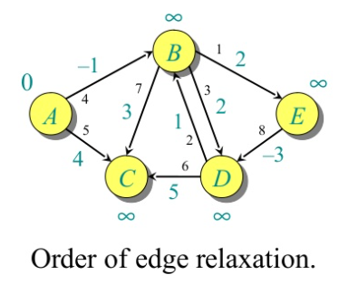
Bellman Ford Algorithm
Numbers in blue color are edges weight.
Numbers in black color represent the order in which edges will be traversed. However you can traverse all edges in any order. Here we will be traversing them in order given by black numbers.

Slide 8
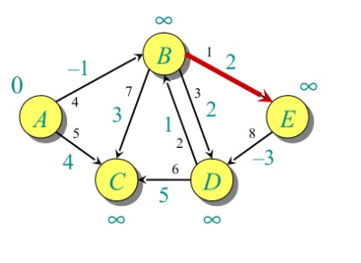
Bellman Ford Algorithm

Slide 9
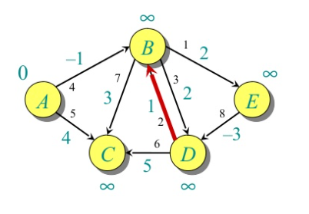
Bellman Ford Algorithm

Slide 10
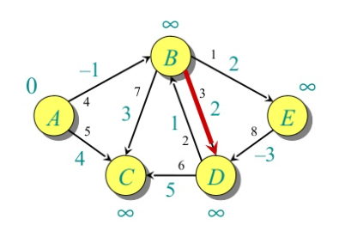
Bellman Ford Algorithm

Slide 11
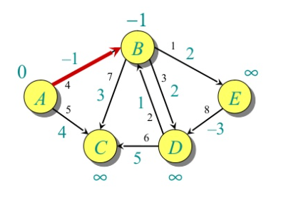
Bellman Ford Algorithm

Slide 12
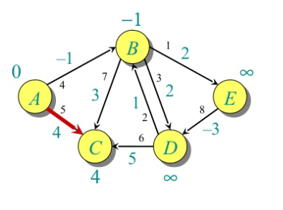
Bellman Ford Algorithm

Slide 13
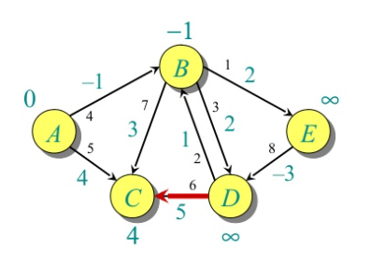
Bellman Ford Algorithm

Slide 14
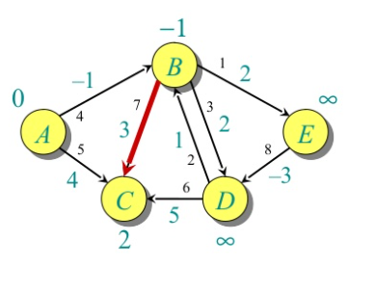
Bellman Ford Algorithm

Slide 15
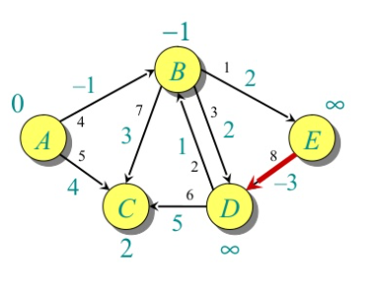
Bellman Ford Algorithm

Slide 16
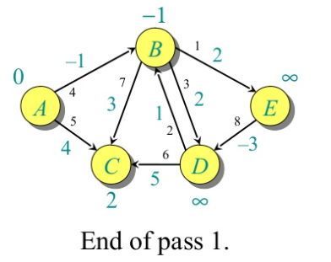
Bellman Ford Algorithm

Slide 17
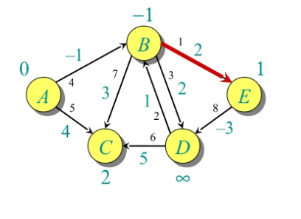
Bellman Ford Algorithm

Slide 18
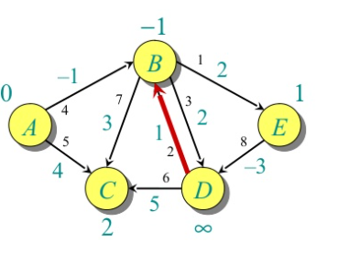
Bellman Ford Algorithm

Slide 19
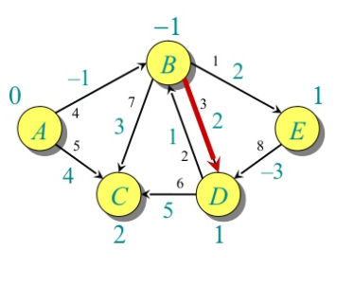
Bellman Ford Algorithm

Slide 20

Bellman Ford Algorithm

Slide 21
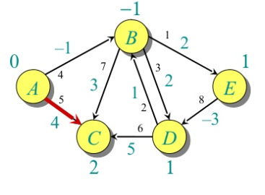
Bellman Ford Algorithm

Slide 22
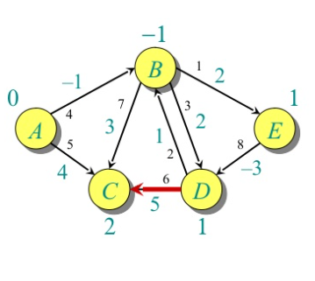
Bellman Ford Algorithm

Slide 23
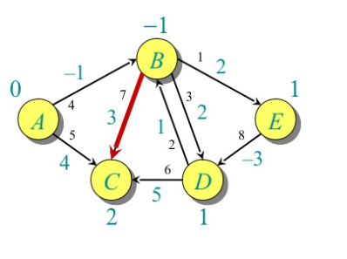
Bellman Ford Algorithm

Slide 24
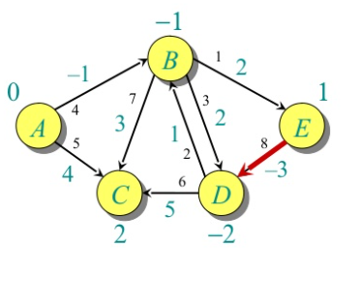
Bellman Ford Algorithm

Slide 25
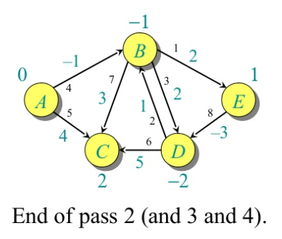
Bellman Ford Algorithm
This is end of pass 2. When you run pass 3 and 4, you will notice there will be no change in vertices value. Now these are final values. For example, Vertex E has value 1 which means that shortest path from A to E has cost 1 (path is ABE). Vertex D has value -2 which means that shortest path from A to D has cost -2 (path is ABED) and so on.

Slide 26
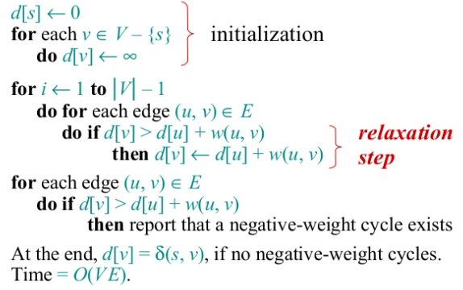
Bellman Ford Algorithm

Slide 27
Bellman Ford Algorithm
Time Complexity :
We relaxed all the edges |V-1| times. So if there are E edges then :
Time complexity = E(|V-1|) = O(E.V)

Slide 28
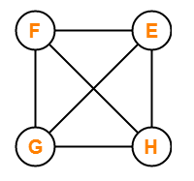
Bellman Ford Algorithm
Complete graph is graph in which we have edge from every vertex to every other vertex. So complete graph will always have edges = V(V-1)/2. Complete graph is shown in figure :
Time complexity in case of complete graph :
(V-1) x (V(V-1)/2) = V^3

Slide 29
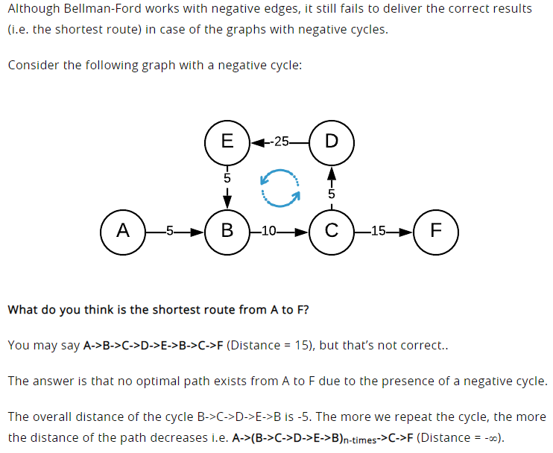
Bellman Ford Algorithm
Why it does not work for negative weight cycle :

